Slide 1


Slide 2
Lecture 1: Introduction
Prof. Seyed Majid Zahedi
https://ece.uwaterloo.ca/~smzahedi

Slide 3
Outline
How do things work in ECE 350?
What is an operating system?
What makes operating systems so exciting?

Slide 4
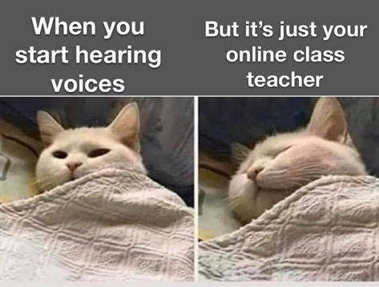
Class is Entirely Online!
Lectures will be on Teams
Links will be provided on LEARN
Recordings will be available afterwards
Office hours will be on Teams
Links will be provided on LEARN
There will be no recordings
No office hours during week 1 and reading week
Lab tutorials will be on delivered asynchronously

Slide 5
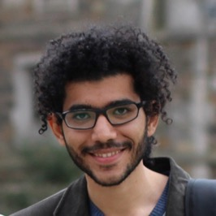
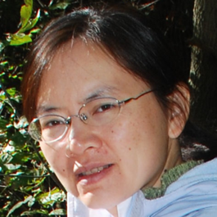
Who Are We?
Instructor: Prof. Seyed Majid Zahedi zahedi@uwaterloo.ca
https://ece.uwaterloo.ca/~smzahedi
Office hours: M&F 14:45 to 15:45 (EST)
Lab instructor: Irene Huang
yqhuang@uwaterloo.ca
Office hours: Tu&Th 11:30 to 12:30, F 16:30 to 17:30 (EST)

Slide 6
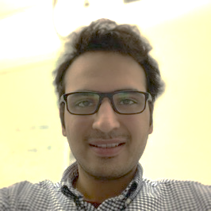
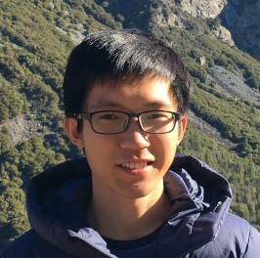
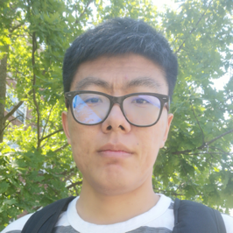
ECE 350 TAs
Ali Hossein Abbasi Abyaneh a36hosse@uwaterloo.ca
Office hours: W 11:30 to 12:30 (EST)
Maizi Liao m7liao@uwaterloo.ca
Weitian Xing w23xing@uwaterloo.ca Office hours: M 16:30 to 17:30 (EST)

Slide 7



Useful Links
Course webpage
https://ece.uwaterloo.ca/~smzahedi/crs/ece350/
Course on Piazza
https://piazza.com/uwaterloo.ca/fall2020/ece350
Anonymous feedback form
https://forms.gle/Ea7kbQhVWLJbphfJA

Slide 8
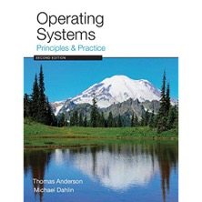

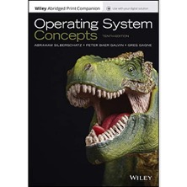
Readings
Main textbook
Operating Systems: Principles and Practice (2nd Edition)
Optional references
Operating Systems: Three Easy Pieces (Freely Available)
Operating System Concepts (10th Edition)

Slide 9
Prerequisite: ECE 252
It is assumed that you know
File system API
File operations, directory structure
Processes and threads
PCB, TCB, process/thread life cycle, fork and exec, signals
Inter-process communication
File sharing, memory sharing, message passing, pipes
Networking
Sockets, ports, client and server programs
Concurrency
Mutual exclusion, mutex, semaphores, locks, condition variables, monitors
Deadlock
Avoidance, detection, recovery, Banker's algorithm

Slide 10
ECE 350 Is a Class About…
Design of key systems abstractions that have emerged over time
Processes, threads, events, address spaces, file systems, sockets, transactions, key-value stores, etc.
Tradeoffs surrounding these designs
Their efficient implementation
Including hardware support that makes them possible and practical
And how to use them effectively

Slide 11
Why Take ECE 350? Why Learn About OS?
Some of you will design and build parts of (real-time) operating systems
Many of you will create systems that use OS concepts
Whether you build hardware or software
Concepts and design patterns appear at many levels
All of you will write programs that use OS abstractions
The better you understand them, the better you use them

Slide 12
Evaluation
Lab project: 70%
5 deliverables (more on this later)
Quizzes: 30%
10-12 quizzes
All online on LEARN
Quizzes are open book
You may consult your textbook, course notes, and materials posted on course webpage
Use of any other resource (including online services such as stackexchange.com) is prohibited
You may not communicate directly or indirectly with any person except course instructors
Important disclaimer
We reserve the right to change these weights at any time during the term without prior notice

Slide 13
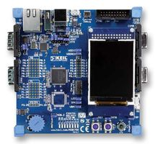

Lab Project
You will design, implement, and test real-time executive (RTX) on Keil MCB1700 Cortex-M3 board

Slide 14
Groups
Groups should have 4 members
Never 5, 3 requires serious justification
Signup in LEARN by 08:30 AM on Sep.14th EST
Each group must have a project manager
Responsible for coordinating group
Can rotate between teammates
Only one split-up is allowed
One-week notice in writing before nearest deadline
All students involved lose one grace day

Slide 15
Milestones
Deliverable | Weight | Due Date
P0 Group sign-up | 2% | 08:30 Sept 14
P1 Memory management | 18% | 20:30 Sept 25
P2 Task management | 20% | 20:30 Oct 09
P3 Synchronization & console I/O | 25% | 20:30 Nov 02
P4 Timing and real-time scheduling | 20% | 20:30 Nov 16
P5 Memory protection & stress tests | 15% | 20:30 Nov 30
All times are Eastern Standard Time
Important disclaimer
We reserve the right to change these weights at any time during the term without prior notice

Slide 16
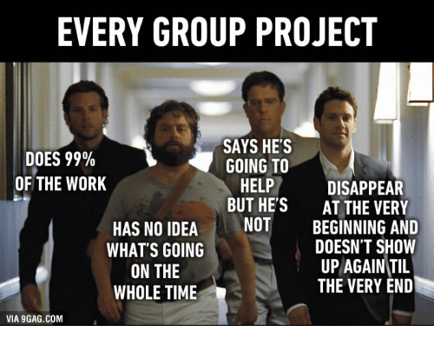
Grades for P1 – P5
Teammates anonymously evaluate each other for each deliverable
Your grade = Your group’s grade x your contribution factor
Peer rating | Contribution factor
[8, 10] | 1
[7,8) | 0.8
[6,7) | 0.6
[4,6) | 0.4
[0,4) | 0

Slide 17
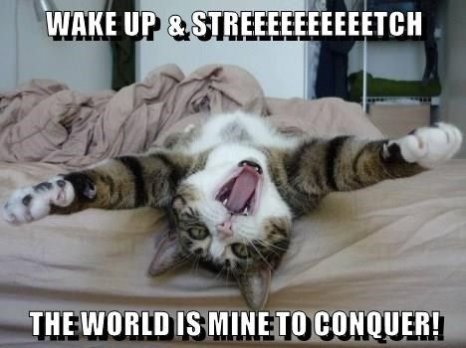
Start Early!
Time/work estimation is hard
Programmers are eternal optimists (it will only take two days)!
This is why we bug you about starting the project early
Can a project be efficiently partitioned?
Partitionable task decreases in time as you add people
But … what about communication?
Time reaches a minimum bound
With complex interactions, time increases!

Slide 18
Techniques for Partitioning Tasks
Functional
Person A implements threads, Person B implements semaphores, Person C implements locks…
Problem: Lots of communication across APIs
If B changes the API, A may need to make changes
Task
Person A designs, Person B writes code, Person C tests
May be difficult to find right balance, but can focus on each person’s strengths (Theory vs systems hacker)
Since debugging is hard, Microsoft has two testers for each programmer

Slide 19
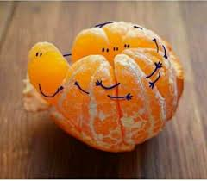
Communication
More people means more communication
Changes have to be propagated to more people
Think about person writing code for most fundamental component of system: everyone depends on them!
Miscommunication is common
“Index starts at 0? I thought you said 1!”
Who makes decisions?
Individual decisions are fast but trouble
Group decisions take time
Centralized decisions require a big picture view (someone who can be the “system architect”)
Often designating someone as system architect can be a good thing
Better not be clueless
Better have good people skills
Better let other people do work
dopl3r.com

Slide 20
Coordination
Many are in different time zones ⇒ some cannot make all meetings!
They miss decisions and associated discussion
Why do we limit groups to 4 people?
You would never be able to schedule meetings otherwise
Why do we require 3 people minimum?
You need to experience groups to get ready for real world
People have different work styles
Some people work in the morning, some at night
How do you decide when to meet or work together?
What about project slippage?
Everyone busy but not talking: One is way behind, but no one will know until very end!
Hard to add people to existing group
Members have already figured out how to work together

Slide 21
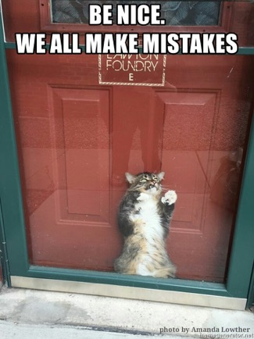
How to Make it Work?
People are human … get over it!
People will make mistakes, miss meetings, miss deadlines, etc.
You need to live with it and adapt
It is better to anticipate problems than clean up afterwards
Document, document, document
Why Document?
Expose decisions and communicate to others
Easier to spot mistakes early
Easier to estimate progress
What to document?
Everything (but don’t overwhelm people or no one will read)

Slide 22
Suggested Documents for You to Maintain
Project objectives: goals, constraints, and priorities
Specifications
This should be the first document generated and the last one finished
Meeting notes
Document all decisions
Schedule
This document is critical!
Organizational chart
Who is responsible for what task?

Slide 23
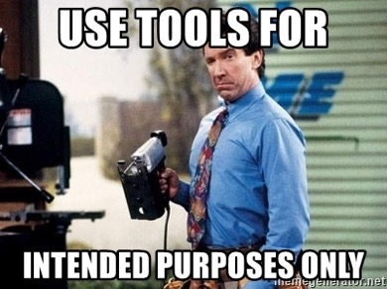
Use Software Tools
Source revision control software (CVS, SVN, git)
Easy to go back and see history
Figure out where and why bugs got introduced
Communicates changes to everyone (use RCS’s features)
Use automated testing tools
Write scripts for non-interactive software
Use E-mail and instant messaging consistently to leave history trail

Slide 24
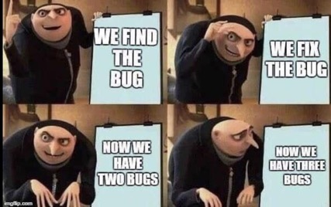
Test Continuously
Integration tests all the time, not at 8pm on due date!
Write dummy stubs with simple functionality
Schedule periodic integration tests
Get everyone code, build, and test … don’t wait until it is too late!
Testing types:
Unit tests: white-/black-box check each module in isolation
Daemons: subject code to exceptional cases
Random testing: subject code to random timing changes
Test early, test later, test again
What if something changes in some other part of code?

Slide 25
Late Submissions
Five grace days (including weekends) without penalty
15% per day late submission penalty afterwards
1-hour-late submission = 15-hour-late submission
Lat submissions are not accepted after three days

Slide 26


Collaboration Policy
Explaining concepts to someone in another group
Discussing algorithms/testing strategies with other groups
Helping debug someone else’s code (in another group)
Searching online for generic algorithms (e.g., hash table)
Sharing code or test cases with another group
Open-sourcing code (e.g., on GitHub) even after this term
Copying OR reading another group’s code or test cases
Copying OR reading online code or test cases from prior years
Zero tolerance policy for plagiarism
We use Moss and follow UW Policy 71 for any single incident

Slide 27

Lab Facilities
No scheduled lab sessions
Tentative project demos: P3, P4, and P5
Englab > ECE > ece-rtos remote desktop
Nexus computers
Keil MCB1700 LPC1768 (Cortex-M3) boards
MDK-ARM MDK-Lite ed. V5.x (32KB code size limit)
ARM compilation tools are included
Simulator is good for development work at home
Simulator may not perfectly match hardware behaviour
Test your code on hardware well before deadlines!
Code that only works on simulator loses 15%

Slide 28
Seeking Help
Lab Q&A on Piazza discussion forum
Looking for group partners
Lab/Project administration
Keil IDE Q&A
Project Q&A
Target response time: one business day
Do not wait till the last minute to ask questions
Individual emails
Only for questions containing confidential information
Office hours
Appointment

Slide 29
Important Near-term Task
Signup for project groups in Learn by
08:30 am on September 14th , 2020 EST

Slide 30


Slide 31
What is an Operating System?
No universally accepted definition
“Everything vendors ship when you order OS” is good approximation, but varies wildly
“The one program running at all times on computer” is kernel
Everything else is either system program (ships with OS) or application program

Slide 32
What is an Operating System? (cont.)
Special layer of software that provides applications access to hardware resources
Abstract view of complex hardware devices
Protected access to shared resources
Security and authentication
Communication amongst logical entities
App1
App2
App3
OS
Hardware

Slide 33

What is an Operating System? (cont.)
Illusionist
Provide clean, easy-to-use abstractions of physical resources
Infinite memory, dedicated machine
Higher level objects: files, users, messages
Masking limitations, virtualization

Slide 34
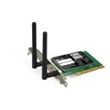
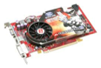


Hardware/Software Interface
Running Program
Software
Instruction Set Architecture (ISA)
Hardware
Memory
PgTbl
& TLB
ECE 222 and ECE 320: Machine structures (and C)
OS abstracts these hardware details from the application
Processor
Cache
OS Memory
Ctrlr
Networks
Storage
Inputs
Displays

Slide 35

OS Basics: Virtualizing Hardware
Compiled
Program
System Libs
Process
Execution environment with restricted rights provided by OS
Threads
Address Spaces
Files
Sockets
Operating System
ISA
Hardware
Processor
PgTbl
& TLB
Memory
Storage
Networks
OS Mem
I/O Ctrlr

Slide 36

What is an Operating System? (cont.)
Illusionist
Provide clean, easy-to-use abstractions of physical resources
Infinite memory, dedicated machine
Higher level objects: files, users, messages
Masking limitations, virtualization
Referee
Provide protection, isolation, and sharing of resources
Resource allocation and communication

Slide 37

OS Basics: Switching Processes
Compiled
Program 1
Compiled
Program 2
System Libs
System Libs
Process 1
Process 2
Threads
Address Spaces
Files
Sockets
Threads
Address Spaces
Files
Sockets
Operating System
ISA
Hardware
Processor
PgTbl
& TLB
Memory
Storage
Networks
OS Mem
I/O Ctrlr

Slide 38
OS Basics: Switching Processes
Compiled
Program 1
Compiled
Program 2
System Libs
System Libs
Process 1
Process 2
Threads
Address Spaces
Files
Sockets
Threads
Address Spaces
Files
Sockets
Operating System
ISA
Hardware
Processor
PgTbl
& TLB
Memory
Storage
Networks
OS Mem
I/O Ctrlr

Slide 39
OS Basics: Switching Processes (cont.)
Compiled
Program 1
Compiled
Program 2
System Libs
System Libs
Process 1
Process 2
Threads
Address Spaces
Files
Sockets
Threads
Address Spaces
Files
Sockets
Operating System
ISA
Hardware
Processor
PgTbl
& TLB
Memory
Storage
Networks
OS Mem
I/O Ctrlr

Slide 40
OS Basics: Switching Processes (cont.)
Compiled
Program 1
Compiled
Program 2
System Libs
System Libs
Process 1
Process 2
Threads
Address Spaces
Files
Sockets
Threads
Address Spaces
Files
Sockets
Operating System
ISA
Hardware
Processor
PgTbl
& TLB
Memory
Storage
Networks
OS Mem
I/O Ctrlr

Slide 41
OS Basics: Protection
Segmentation fault (core dumped)
Compiled
Program 1
Compiled
Program 2
System Libs
System Libs
Process 1
Process 2
Threads
Address Spaces
Files
Sockets
Threads
Address Spaces
Files
Sockets
Operating System
Operating System
ISA
Hardware
Processor
PgTbl
& TLB
Memory
Storage
Networks
OS Mem
I/O Ctrlr

Slide 42

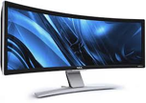
OS Basics: Protection (cont.)
Process 1
Process 2
Process 3
Software
OS Hardware Virtualization
Hardware
ISA
Memory
OS isolates processes from each other
OS isolates itself from other processes
… even though they run on the same HW!
Processor
Protection Boundary
OS Memory
Ctrlr
Displays
Storage
Networks
Inputs

Slide 43

What is an Operating System? (cont.)
Illusionist
Provide clean, easy-to-use abstractions of physical resources
Infinite memory, dedicated machine
Higher level objects: files, users, messages
Masking limitations, virtualization
Referee
Provide protection, isolation, and sharing of resources
Resource allocation and communication
Glue
Provide common services
Storage, window system, networking, sharing, authorization
Look and feel

Slide 44
OS Basics: I/O
Process 1
Process 2
Process 3
Software
OS Hardware Virtualization
Hardware
ISA
Memory
Processor
Protection Boundary
OS Memory
OS provides common services in the form of I/O
Ctrlr
Displays
Storage
Networks
Inputs

Slide 45

OS Basics: Look and Feel
Compiled
Program
System Libs
Process
Execution environment with restricted rights provided by OS
Threads
Address Spaces
Files
Sockets
Windows
OS
ISA
HW
Processor
PgTbl
& TLB
Memory
Storage
Networks
Displays
OS Mem
I/O Ctrlr

Slide 46
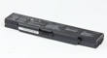
OS Basics: Background Management
Compiled
Program
System Libs
Process
Execution environment with restricted rights provided by OS
Threads
Address Spaces
Files
Sockets
Windows
OS
Network Manager
Power Manager
ISA
HW
Processor
PgTbl
& TLB
Memory
Storage
Networks
Displays
Battery
OS Mem
I/O Ctrlr

Slide 47
OS Basics: Hardware Support
OS bottom line is to support applications!
OS itself is incidental
Ideally, OS should have very low performance overhead over raw hardware
OS relies on HW support to provide abstractions efficiently
Dual-mode operation, interrupts, traps, precise exceptions, memory management unit, translation lookaside buffer, etc.
HW support and OS design continue to co-evolve…
… as hardware performance improves (e.g., faster storage/network), …
… and application requirements change
What we study in this class is result of decades of co-evolution!

Slide 48









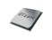
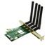
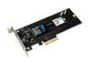
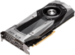
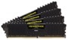
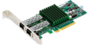
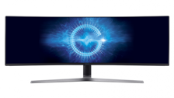
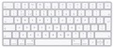
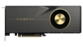
What Do Operating Systems Do?
Provide abstractions to applications
File systems
Processes, threads
Virtual memory
Naming system, …
Manage diverse resources
Memory, CPU, storage, . . .
Achieves above by implementing specific algorithms and techniques
Scheduling
Concurrency
Transactions
Security, …

Slide 49
What Do Operating Systems Do? (cont.)
Manage hardware resources for users and applications
Convert what hardware gives into something that application programmers want
For any OS component, begin by asking two questions:
What is hardware interface? (physical reality)
What is application interface? (virtual machine)
Notes:
In some sense, OS is just a software engineering problem
The first interface is an abstract virtual machine – an abstraction that allows programmers to ignore the OS.
And under all of that is another abstraction, that allows the OS to run on a variety of different hardware .
That way, you can change the underlying hardware, without changing (much of) the OS.

Slide 50
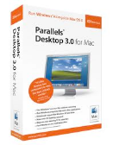



Virtual Machines (VMs)
Software emulation of abstract machine
Gives programs illusion that they own entire machine
Makes it look like hardware has features programs want
Two types of virtual machines
Process VM: supports execution of single program (e.g., Java)
System VM: supports execution of entire OS (e.g., VMWare Fusion, Virtual box, Parallels Desktop, Xen)

Slide 51
Process VMs
Programming simplicity
Each process thinks it owns all devices
Each process thinks it has all memory/CPU time
Device interfaces more powerful than raw hardware
Bitmapped display ⇒ windowing system
Ethernet card ⇒ reliable, ordered, networking (TCP/IP)
Fault isolation
Processes unable to directly impact other processes
Bugs cannot crash whole machine
Protection and portability
Java interface safe and stable across many platforms

Slide 52
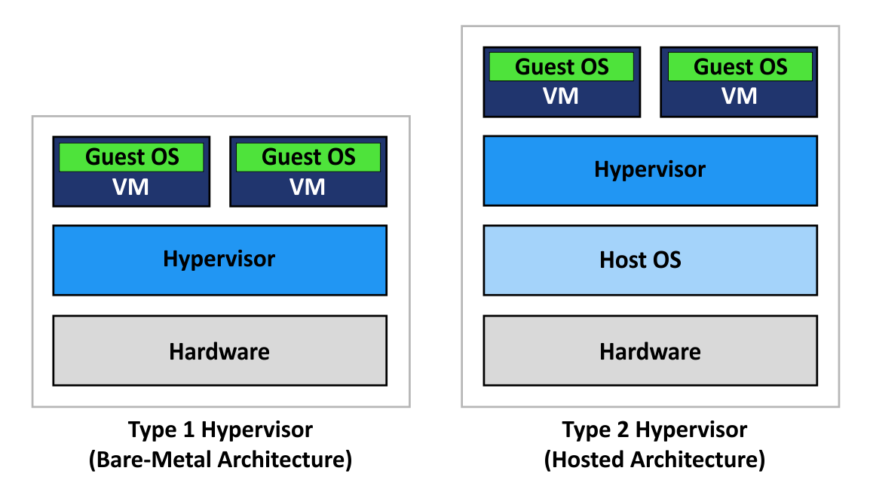
System Virtual Machines: Layers of OSes
VMs are useful for OS development and testing programs on other OSes
Hypervisors create and run virtual machines
Type-1 hypervisors allocate HW to VMs in addition to managing them
E.g., Xen, VMWare ESXi
Type-II hypervisors rely on host OS for HW management
E.g., Virtual Box, VMWare Workstation, KVM
www.nakivo.com
Notes:
Example of system vm layout!

Slide 53
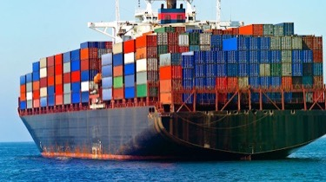
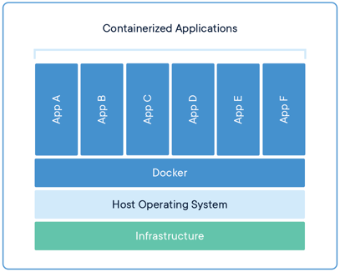
Containers: Low-weight Alternatives to Full-system Virtualization
Do not provide full-machine abstraction
Use OS constructs to provide sand boxes for execution
E.g., Linux cgroups, namespaces, etc.
Can run on bare metal, or atop of VMs
OS containers: provide virtualized OSes above single shared kernel
E.g., LXC, OpenVZ, FreeBSD Jail
Application containers: expect single application to execute within container
E.g., Docker, rkt

Slide 54
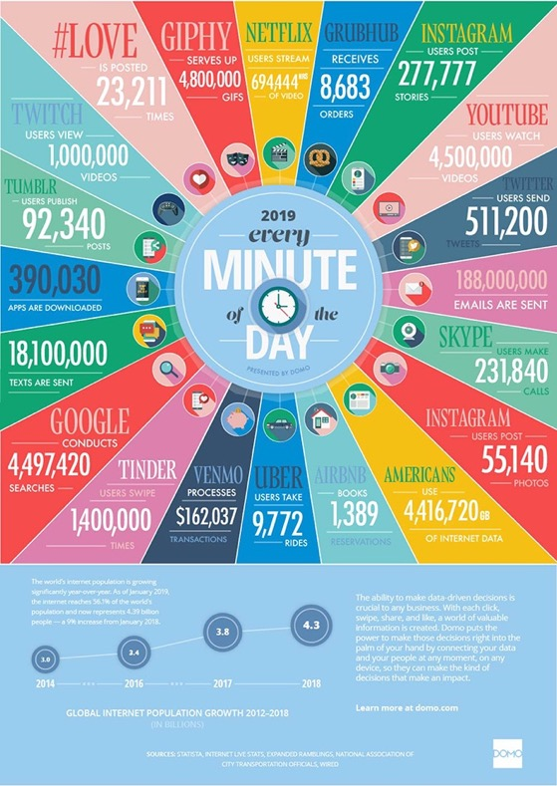
What Makes Operating Systems so Exciting and Challenging?
Operating systems are at the heart of it all …
Challenges
Keeping up with evolving HW
Managing ever-growing complexity of SW

Slide 55
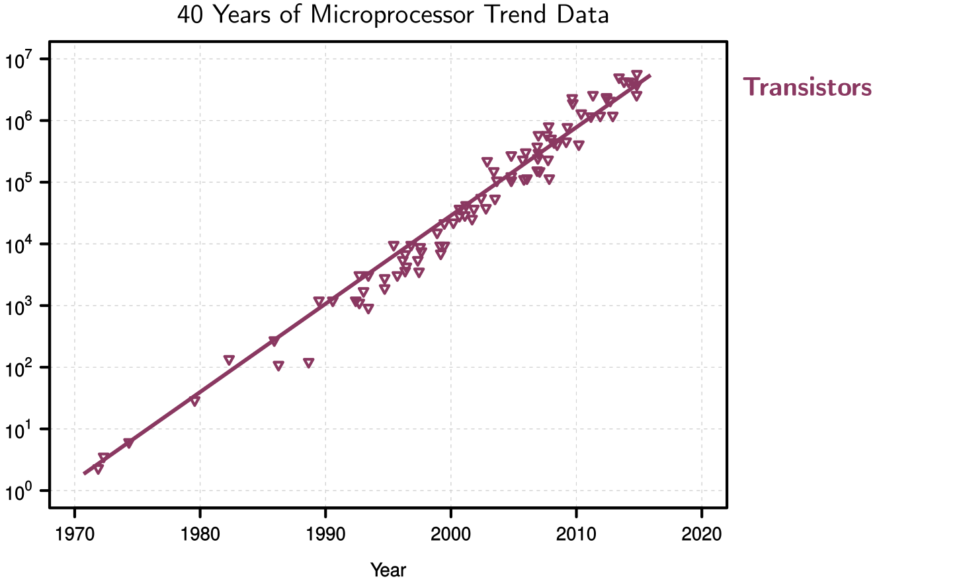
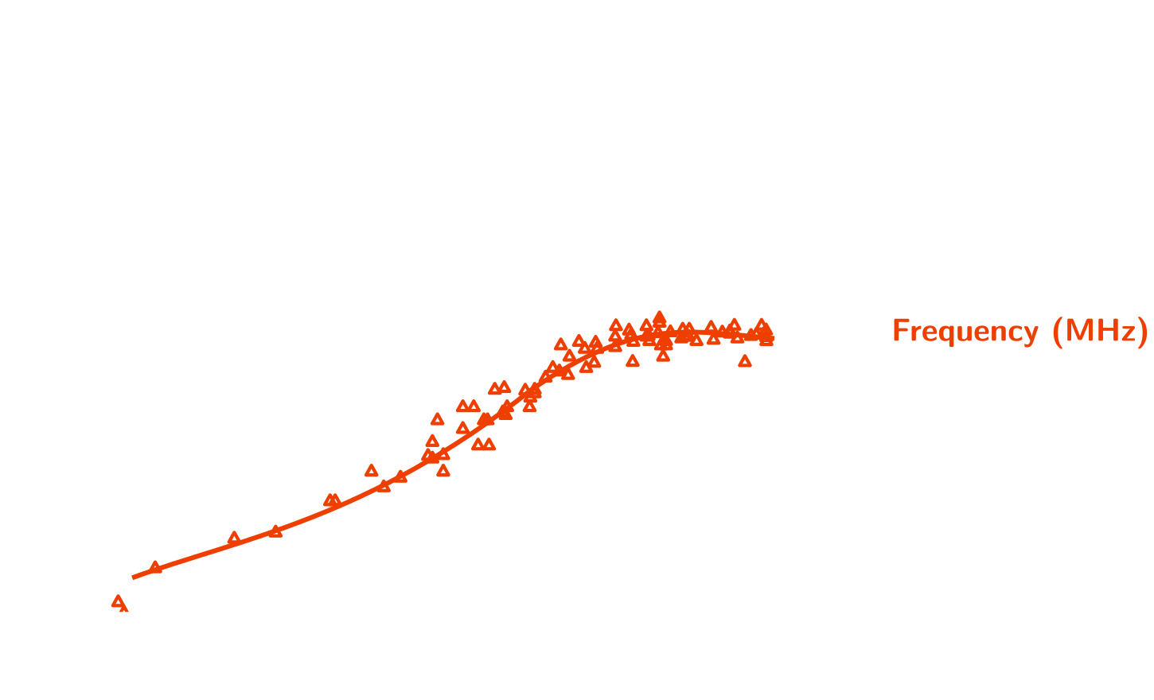
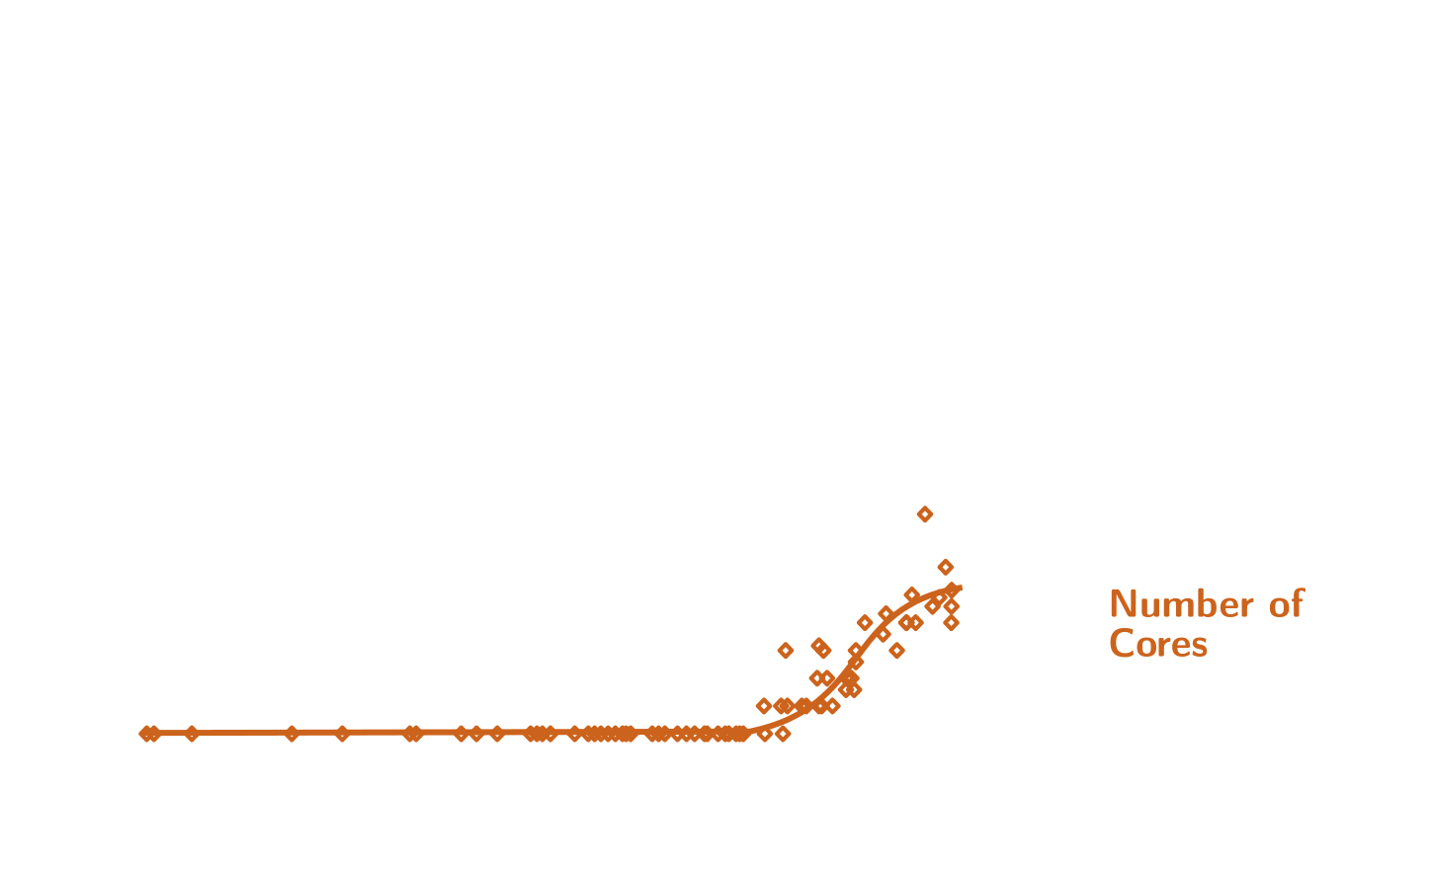
Technology Trends
How do we program these?
Parallelism must be exploited at all levels
[Moore’s Law 1965]
Dark Silicon [Esmaeilzadeh et al. 2011]
Multiprocessor melts if all cores simultaneously run at full capacity
End of Dennard Scaling
[R. Dennard et al. 1974]
Notes:
If we want our designed system to last for a decade, we better design them knowing what’s coming. That’s why we need to study trends in computing technologies.

Slide 56
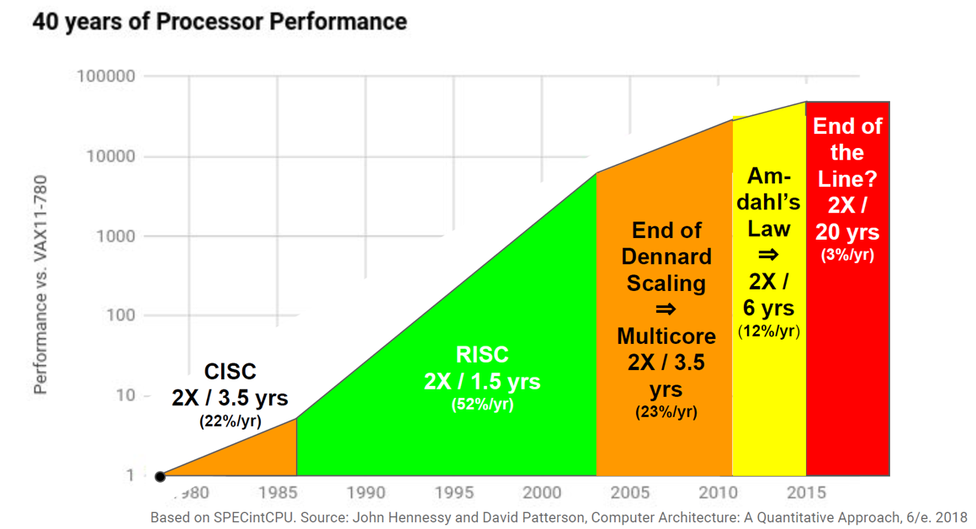
End of Growth of Single Program Speed
From John Hennessy and David Patterson’s 2017 ACM A.M. Turing Award Lecture

Slide 57
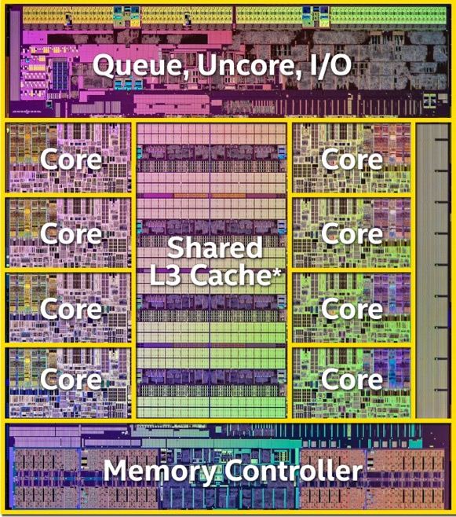
Modern Processors
Intel Haswell E
Intel Xeon Platinum 9282
14nm processor
56 cores, 112 threads
1.75MB data and ins. L1 cache
56MB L2 cache
77MB shared L3 cache
8B transistors
AMD EPYC 7H12
7nm processor
64 cores, 128 threads
2MB data and ins. L1 cache
32MB L2 cache
256MB shared L3 cache
4.8B transistors
www.extremetech.com
Notes:
How to program these?
- Use 2 CPUs for video/audio
- Use 1 for word processor, 1 for browser
- 61 for virus checking???
Parallelism must be exploited at all levels

Slide 58
Memory Hierarchy
Smaller Faster Costlier (per byte)
Reg.
L1 cache
SRAM
L2 cache
SRAM
L3 cache
SRAM
Main memory
DRAM
Local secondary storage
Remote secondary storage
(e.g., distributed file systems)
Larger Slower Cheaper (per byte)
Notes:
As a system programmer and designer, we need to know how much it costs to access data depending on where it’s stored.

Slide 59
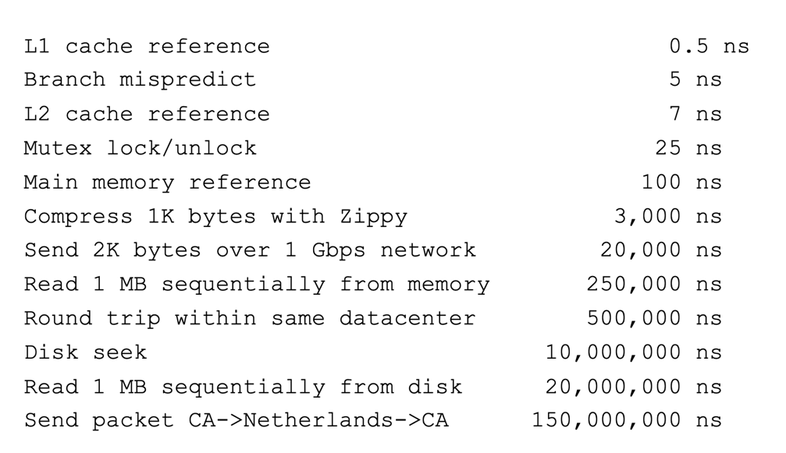
Numbers Everyone Should Know [Jeff Dean, 2009]
Key stroke ~100 ms

Slide 60
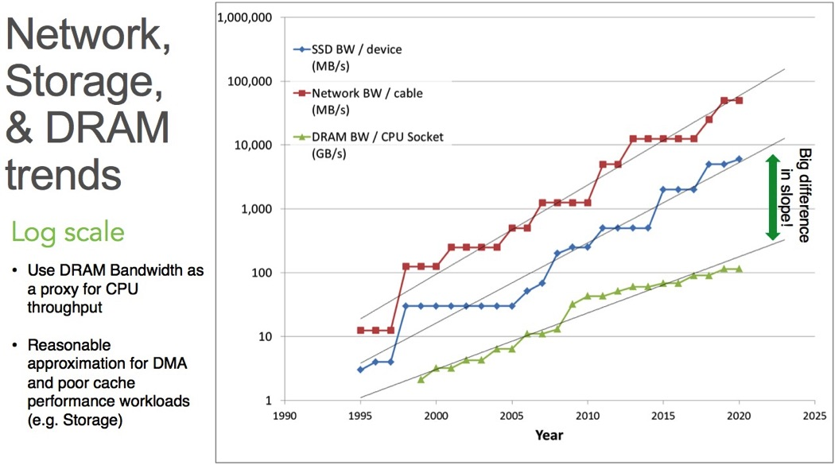
Network, IO, and Memory Bandwidth Trends
twiki.cern.ch

Slide 61
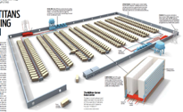
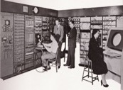
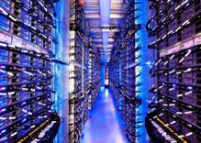
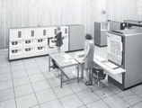
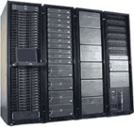
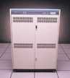
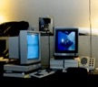

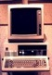


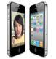
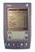


People to Computer Ratio Trend
Computers
Per Person
Number crunching, Data Storage, Massive Inet Services,
ML, …
01:10⁶
Mainframe
01:10³
Mini
Workstation
Productivity,
Interactive
PC
Laptop
01:01
PDA
Cell
Streaming from/to physical world
10³:01
years
Internet of Things!
Bell’s Law: new computer class per 10 years

Slide 62
Early vs Current Operating Systems
One user/application at a time
Had complete control of hardware
OS was runtime library
Users would stand in line to use the computer
Batch systems
Keep CPU busy by having a queue of jobs
OS would load next job while current one runs
Users would submit jobs, and wait, and wait, and wait …
Multiple users on computer at the same time
Multiprogramming: run multiple programs at same time
Interactive performance: try to complete everyone’s tasks quickly
As computers became cheaper, more important to optimize for user time, not computer time
Notes:
For single-user systems, processor remained idle while the user loaded the program
For batch systems, upgrading OS would turn back computer into single-user system

Slide 63
Complexity
Applications consisting of…
… a variety of software modules that …
… run on a variety of devices (machines) that
… implement different hardware architectures
… run competing applications
… fail in unexpected ways
… can be under a variety of attacks
Not feasible to test software for all possible environments and combinations of components and devices
Question is not whether there are bugs but how serious are bugs!

Slide 64

Kernel Complexity
20M
15M
Lines of Code in Linux Kernel
10M
05M
Kernel Versions
Notes:
This shows the growth in the complexity of the Linux kernel. Along this growth, the amount of patches and fixes has generally grown as well.

Slide 65
How do We Tame Complexity?
Every piece of computer hardware different
Different CPU
Pentium, ARM, PowerPC, ColdFire
Different amounts of memory, disk, …
Different types of devices
Mice, keyboards, sensors, cameras, fingerprint readers, touch screen
Different networking environment
Cable, DSL, Wireless, …
Questions:
Does programmer need to write single program that performs many independent activities?
Does every program have to be altered for every piece of hardware?
Does one faulty program crash everything?
Does every program have access to all hardware?

Slide 66
Summary
OS provides VM abstraction to handle diverse HW
OS simplifies application development by providing standard services
OS coordinates resources and protect users from each other
OS can provide fault containment, fault tolerance, and fault recovery
ECE 350 combines ideas and concepts from many other areas of computer science and engineering
Languages, data structures, hardware, and algorithms

Slide 67

Questions?
globaldigitalcitizen.org

Slide 68
Acknowledgment
Slides by courtesy of Anderson, Culler, Stoica, Silberschatz, Joseph, Canny, and Kumar

